Slide 1
INPUT
DEVICES
Name : Pawan Mahadu Sarule
Class : FYBCA (Sci)

Slide 2

INTRODUCTION
An input device is used to feed data into a computer.
It is also defined as a device that provides communication between the user and the computer.

Slide 3


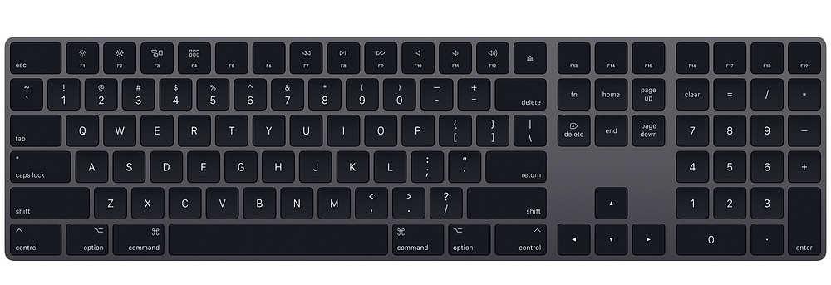
Most common input device.
Designed like a conventional typewriter.
Allows to input alphabets, numbers, and other characters.
Provides keys for additional functions.
Detect the key being pressed and generates the corresponding ASCII code which can be recognised by the computer.
KEYBOARD

Slide 4

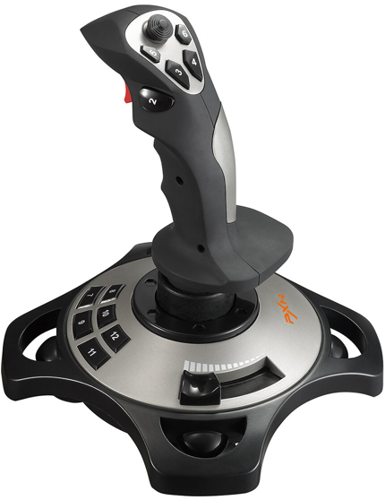

JOYSTICK
Used for playing video games, controlling training simulators and robots.
Joysticks and other game controllers can also be used as pointing devices.
Vertical stick which can move in any direction.
Controls objects in a video game or to make menu selections by the movement of a cursor displayed on the screen.
It has a button on the top that is used to select the option pointed by the cursor.

Slide 5

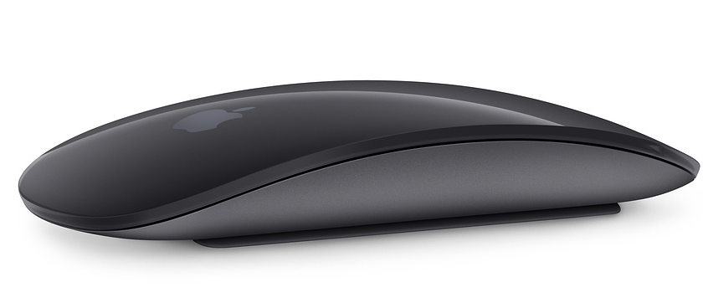

Small handheld device used to indicate cursor on screen
It has one or more buttons and possibly a scroll wheel.
The different types of mouse
ball,
optical,
laser mouse
MOUSE

Slide 6

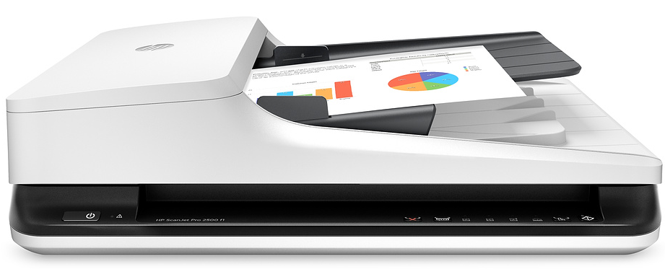
Scanning is a process of taking a close-up photograph.
Scanner is an input device which functions like a photocopying machine.
The scanned image Converted in to digital data.
The scanned picture or document can be saved in the computer.
SCANNER

Slide 7


